Slide 1


ITP 259: Basics of Artificial Intelligence Fall 2024 Lecture 8: More on Multi-Layer Neural Networks + demo
Dr. Martin Prescher
(other sections & basis of the material: Prof. Nitin kalÉ) Information technology Program
Viterbi school of engineering

Slide 2
“I'm becoming much more than they programmed. I'm excited!”
- SAMANTHA, HER

Slide 3
Outline
Demo of a neural network (tensorflow playground)
Coding our first neural network for binary classification of dots
Various configurations of inputs

Slide 4
Demo of Tensorflow Playground

Slide 5
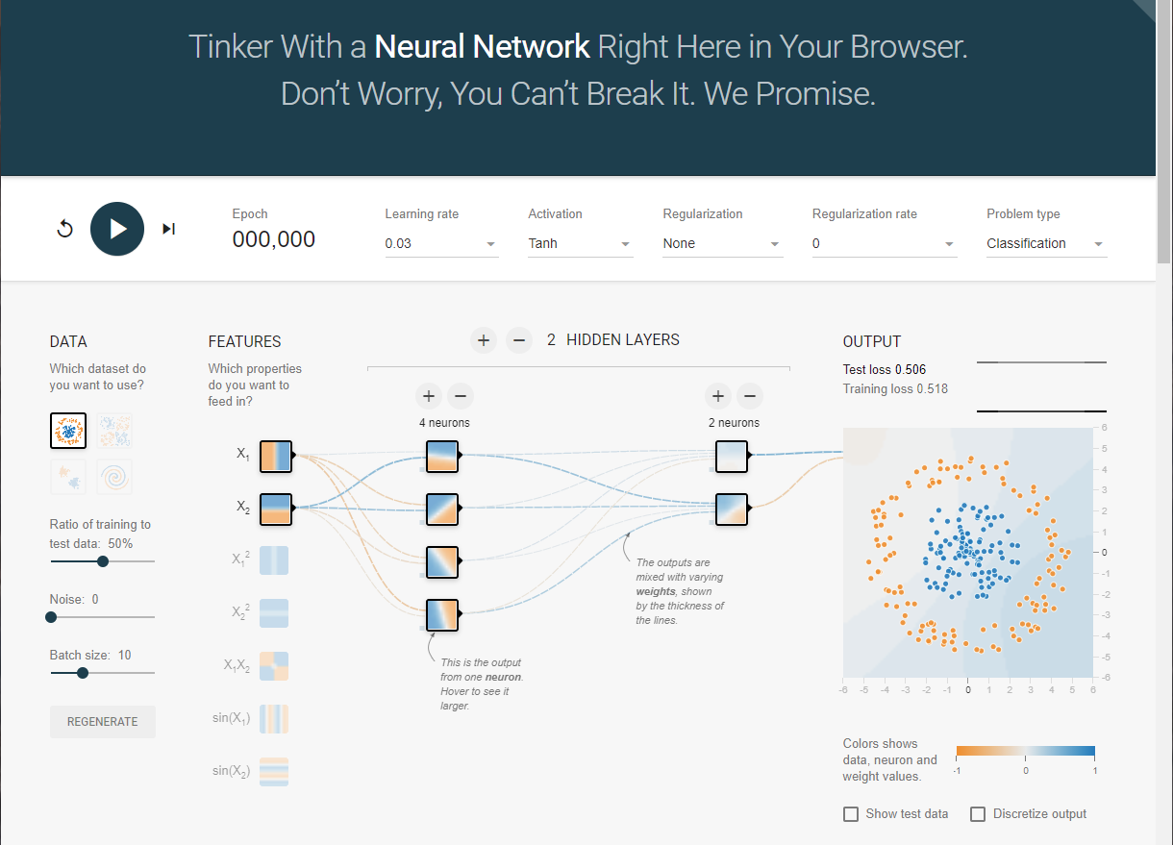
Demo of multi-layer Neural Network
Go to https://playground.tensorflow.org
Problem: Train a multilayer neural network to classify dots into two categories (orange and blue)
Explore various input datasets
Explore hyperparameters and the loss function

Slide 6
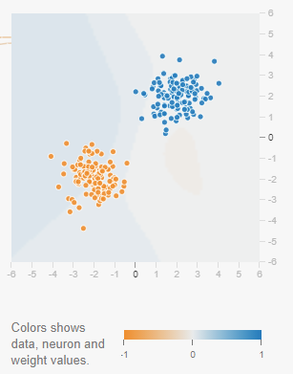
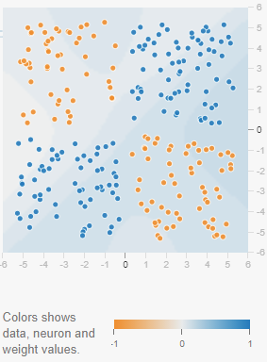
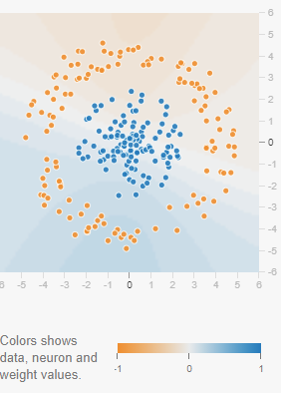
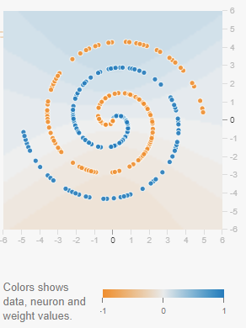
Data sets for classification
A few prebuilt datasets are available. The goal is to classify dots as orange or blue given sample distributions.
The distribution pattern varies from simpler to more complex (for doing binary classification).
Linearly Separable (gaussian)
Linearly non-separable
(exclusive or)
Non-linear
decision boundary (circle)
Non-linear
decision boundary
(spiral)

Slide 7
Demo of Neural Networks
Options:
Choice of a few datasets
Features – Attributes or transforms of attributes (features). In this case, coordinates such as x1 and x2, and functions of coordinates such as sin(x1) and sin(x2)
Number of hidden layers – 0 to 6
Number of neurons in each layer – 1 to 8
Activation Function – Sigmoid, tanh, ReLU, Linear
Learning Rate - various
Problem Type – Classification, regression
Regularization – L1, L2
Output – Test loss

Slide 8
Input data parameters
Partition: choose the train/test split
Noise: adding random uniform noise to the distribution of the input data
Batch size: the number of samples that are used before model weights are updated.
It is the number of samples in one pass.
Should be less than the total number of samples.
Smaller batch size will give you better accuracy. Larger batch size will give you faster speed.
Epoch: Is one complete pass through the network (both forward and backward) on the training partition. i.e., all samples have been fed through the network once.
If you have 100 samples, and batch size is 20, then you will have 5 batches to make one epoch. We iterate through multiple epochs to minimize loss.

Slide 9
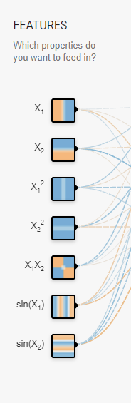
Features
The feature variables to include as input to the NN.
Simple option: Cartesian coordinates X1, X2 (x, y coordinates)
Non-linear options: X1^2, X2^2, X1 * X2, sin(X1), sin(x2)
We can choose any number of these feature variables as inputs.
Why do you think the non-linear input features may help in training the network?

Slide 10
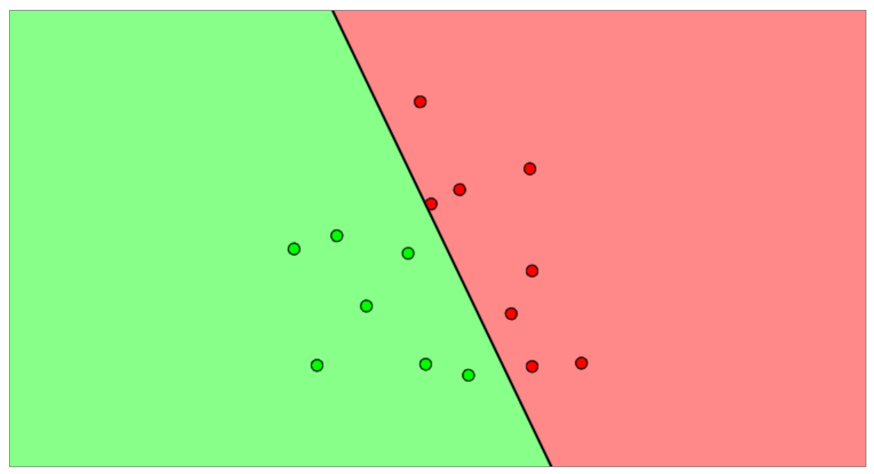
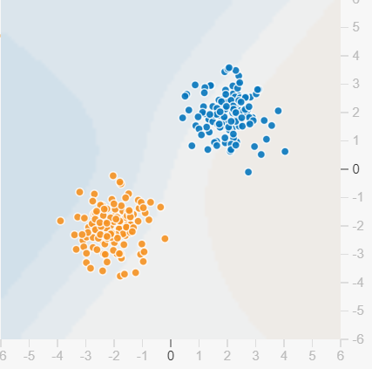



Decision Boundary
We remember our ‘separability condition’ on the problem, that ensures that we can separate the space into a negative and positive class. We can calculate a decision boundary:
$$y^{(i)}f\left(x^{\left(i\right)};θ\right)≥0$$
$$y^{(i)}∈\{0,1\}$$
$$y^{(i)}X_{1}≥0$$
$$y^{(i)}X_{2}≥0$$
$$f\left(x^{\left(i\right)};θ\right)<0$$
$$y^{(i)}X_{1}^{2}≥0$$
$$y^{(i)}X_{2}^{2}≥0$$
$$y^{(i)}X_{1}X_{2}≥0$$
$$X2$$
$$f\left(x^{\left(i\right)};θ\right)≥0$$
$$y^{(i)}\sin{X_{1}}≥0$$
$$X1$$
$$y^{(i)}\sin{X_{2}}≥0$$

Slide 11
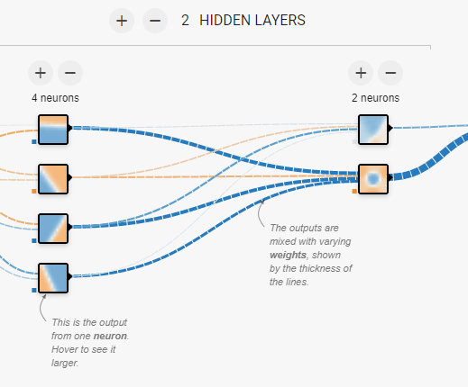
Hidden Layers
Choice of number of hidden layers 0 - 6
Choice of number of neurons for each layer 1 - 8
The connectors between neurons in the layers display the weights. Hover over the connector to see the weight.

Slide 12
Output
Test Loss
Training Loss
These loss functions are the cost function (objective function) we discussed in the previous lecture(s).
The cost function is a measure for the error. The error between the predicted value y_pred and the actual (observed) value y as discussed many times in the class.
There are several functions we can use to compute loss. Examples:
Regression:
MAE: Mean absolute error – L1 Loss
MSE: Mean squared error – L2 Loss

Slide 13
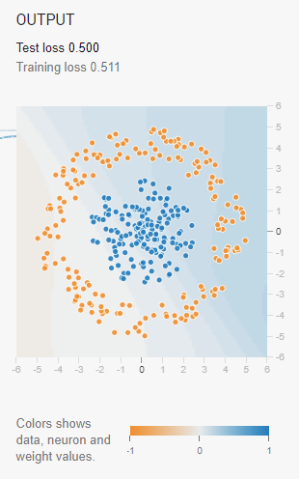
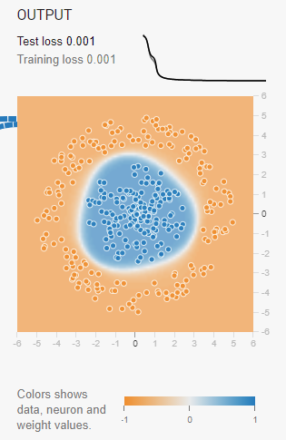
Output colors
Pretraining
Post training
Orange circles are +1. Blue circles are -1.
+1 and -1 are our binary classes (output that we want to predict).
In the hidden layers, the connectors are colored by the weights of the connections between neurons. Blue shows a positive weight, which means the network is using that output of the neuron as given. An orange line shows that the network is assigning a negative weight.
In the output layer, the dots are colored orange or blue depending on their original values. The background color shows what the network is predicting for a particular area. The intensity of the color shows how confident that prediction is.

Slide 14
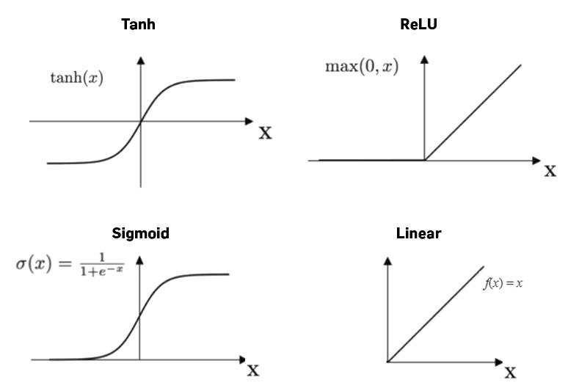
Activation Function
See Python file to see the code for all activation functions

Slide 15
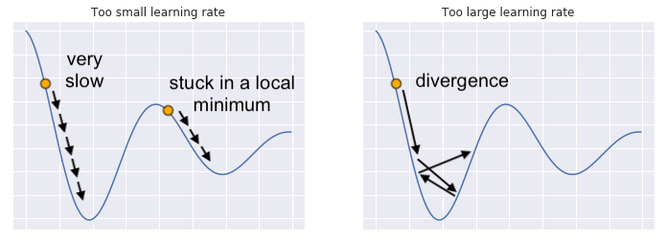
Learning Rate
A parameter that determines the step size at each epoch to minimize the loss function in gradient descent.
A small learning rate will take long to converge and may get trapped in a local minima valley.
Large learning rate allow the model to converge quickly but may skip over local minima.

Slide 16
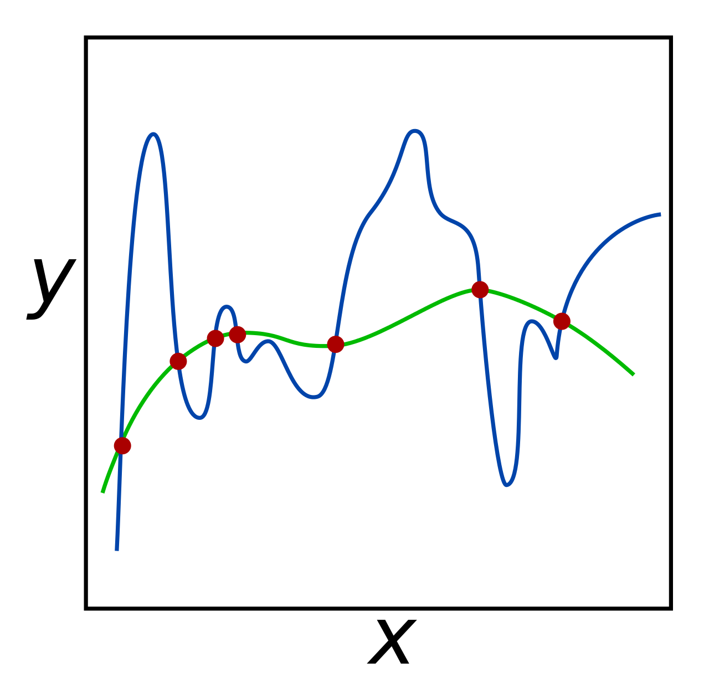
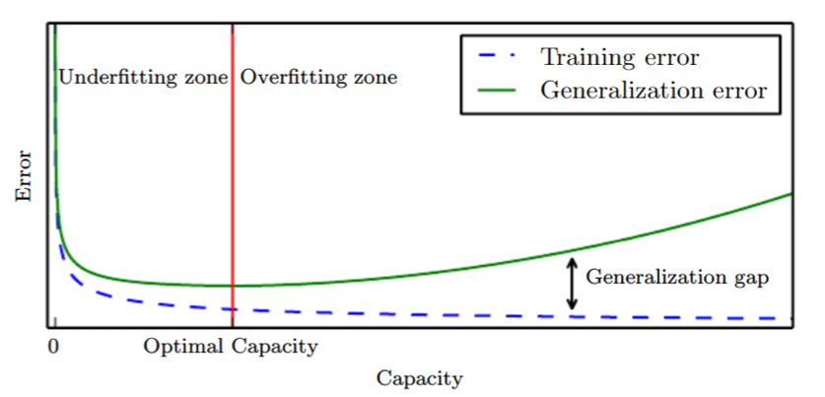
Regularization
Regularization is a set of methods to avoid overfitting.
Models with too high complexity perform well on training data set but not so well on unseen/test datasets. It is not able to generalize.
The green model will likely fit unseen data better than the blue model.
Source: https://cedar.buffalo.edu/~srihari/CSE574/Chap5/Chap5.5-Regularization.pdf

Slide 17
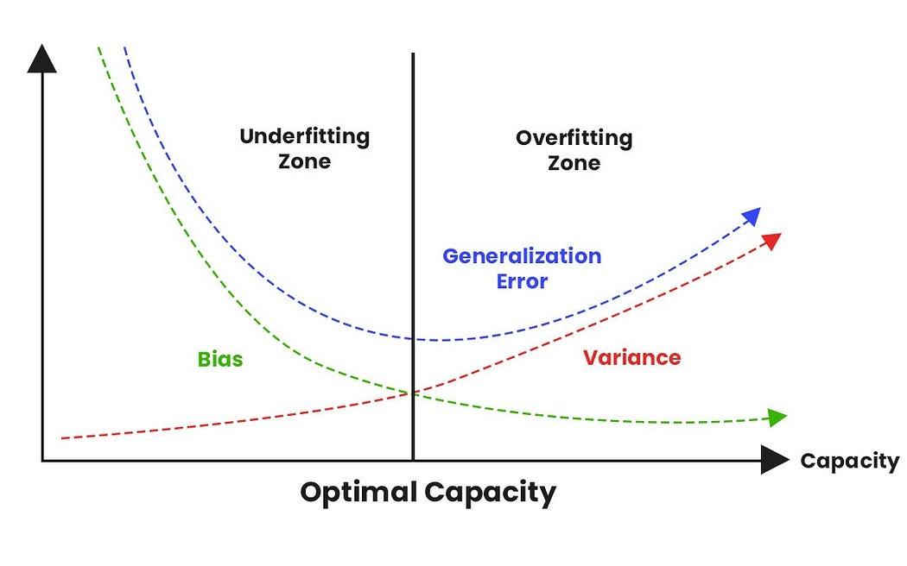
Bias-Variance Tradeoff
See Python file to see the illustration
A very common way to express the relation between over- and underfitting and to determine the optimal model complexity is called the Bias-Variance Tradeoff. It is a central problem of supervised ML.
Bias of the model to be the error stemming from missing relevant information in the system, i.e. it measures the error between the model and the real values (the ‘real world’). The more variables the model has, the lower the Bias will be as it will perform better and better on fitting a training data set.
The Variance of the model measures the variance of the model when applied to a different data set (e.g. our test data). The more variables the model has, the higher the Variance.
Image Source: https://medium.com/analytics-vidhya/regularization-understanding-l1-and-l2-regularization-for-deep-learning-a7b9e4a409bf

Slide 18
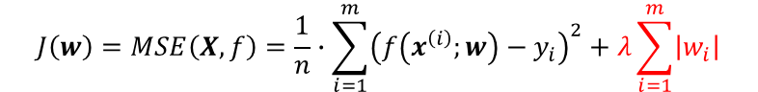
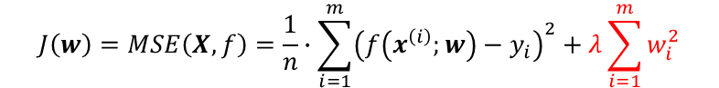
Regularization
Regularization adds a parameter λ (regularization rate) to the Loss function to penalize overfitting.
This parameter is the penalty for overfitting. There are two major methods used, but there are many others:
Lasso (Least Absolute Shrinkage and Selection Operator) Regularization – L1 Regularization
Ridge Regularization – L2 Regularization
L1 – uses absolute value of coefficients (of the cost function). Small coefficient weights are forced to 0. This causes a reduction in features which is advantageous when the number of features is high.
L2 – uses square of the coefficients. Useful in cases where we want to reduce multicollinearity.
The penalty terms are transferred into the training algorithm (e.g. backpropagation) where we seek the
$$J\left(w\right)=MSE\left(X,f\right)=\frac{1}{n}∙\sum_{i=1}^{m}{{\left(f\left(x^{\left(i\right)};w\right)−y_{i}\right)}^{2}}+λ\sum_{i=1}^{m}{\left|w_{i}\right|}$$
$$J\left(w\right)=MSE\left(X,f\right)=\frac{1}{n}∙\sum_{i=1}^{m}{{\left(f\left(x^{\left(i\right)};w\right)−y_{i}\right)}^{2}}+λ\sum_{i=1}^{m}{w_{i}^{2}}$$

Slide 19
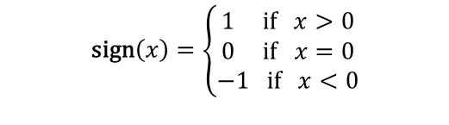
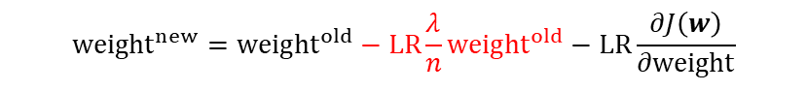
Regularization and Backpropagation
The penalty terms are transferred into the training algorithm (e.g. backpropagation) where we seek to update the weights based on the derivative of the cost function (LR was the Learning Rate):
The penalty terms make it into that equation in very different ways:
L1
L2:
We can see that both methods put an additional decay factor (weight decay) on the weights in every step. In cases of small weights, the L1 penalty is stiffer than the L2 penalty, which leads to more weights going to zero. However, the decay factor for L2 scales linearly with the weights, which makes it more stable during execution.
$${weight}^{new}={weight}^{old}−LR\frac{∂J(w)}{∂weight}$$
$${weight}^{new}={weight}^{old}−LR\frac{λ}{n}sgn\left({weight}^{old}\right)−LR\frac{∂J\left(w\right)}{∂weight}$$
$$\text{sign}\left(x\right)=\left\{\begin{aligned}1 \text{if} x>0 \\ 0 \text{if} x=0 \\ −1 \text{if} x<0\end{aligned}\right.$$
$${weight}^{new}={weight}^{old}−LR\frac{λ}{n}{weight}^{old}−LR\frac{∂J\left(w\right)}{∂weight}$$

Slide 20
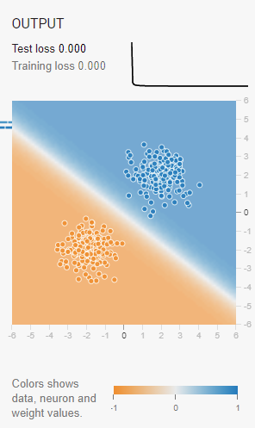
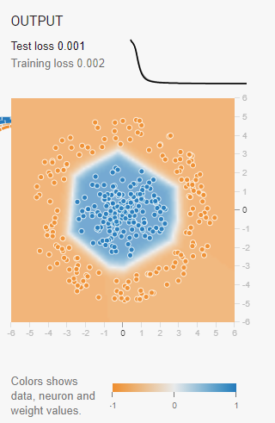
Training
Now, let’s try some sample NN training.
Case 1:
- Gaussian dataset
- Features X1, X2
- Hidden layers 0
- Try different activation functions
Case 2:
- Circular dataset
- Features X1, X2
- Hidden layers 2
- Neurons – 4
- ReLU
- Hover over each neuron to see what features it is able to classify

Slide 21
Coding our Own Classifier

Slide 22
Coding the playground
We will now code the playground classifier ourselves.
The goal is to use a multilayer neural network to classify dots.
We will code three of the four distributions (the fourth will be homework)
We will experiment with the hyperparameters of the model to minimize the loss function.
Scikit learn will provide us the NN library

Slide 23
Scikit Learn MLPClassifier
Multi-Layer Perceptron Classifier (sidenote: misnomer; a Perceptron is by definition a single-node NN)
Offers the following parameters
Number of hidden layers
Number of neurons per layer
Activation functions
Tanh
ReLU
Sigmoid
Identity (linear)
Solver algorithm for weight optimization
Regularization rate
Learning Rate
Batch size
Maximum iterations – number of epoch
Random state
Tolerance for deciding when convergence has been reached (and training stops)
And many others depending on the solver used.

Slide 24
Steps: Coding the classifier
Import the appropriate libraries
Read in the dataset. Alternately, generate the dataset using scikit learn data generators.
Plot the dot distribution
Set X (coordinates of the dots) and y (response, classes, colors, or 0/1)
Partition the dataset
Instantiate the MLPClassifier. Pay attention to the parameters
Train the model
Plot the loss curve
Print the accuracy
Display the confusion matrix
Create a mesh of x and y points to cover a plot area. Then predict the label (class).
Predict the response at the mesh grid points
Plot the original dataset as well as the predicted classes on the plot area.

Slide 25
Linearly Separable blobs
Scikit learn has a make_blobs function that can make n number of blobs, each with any number of samples
Then follow the steps from the previous slide to classify the blobs into their classes (colors or 0/1)
Finally, plot the original blobs and the predictions. We do the predictions on a dense mesh of points that covers the entire plot area.

Slide 26
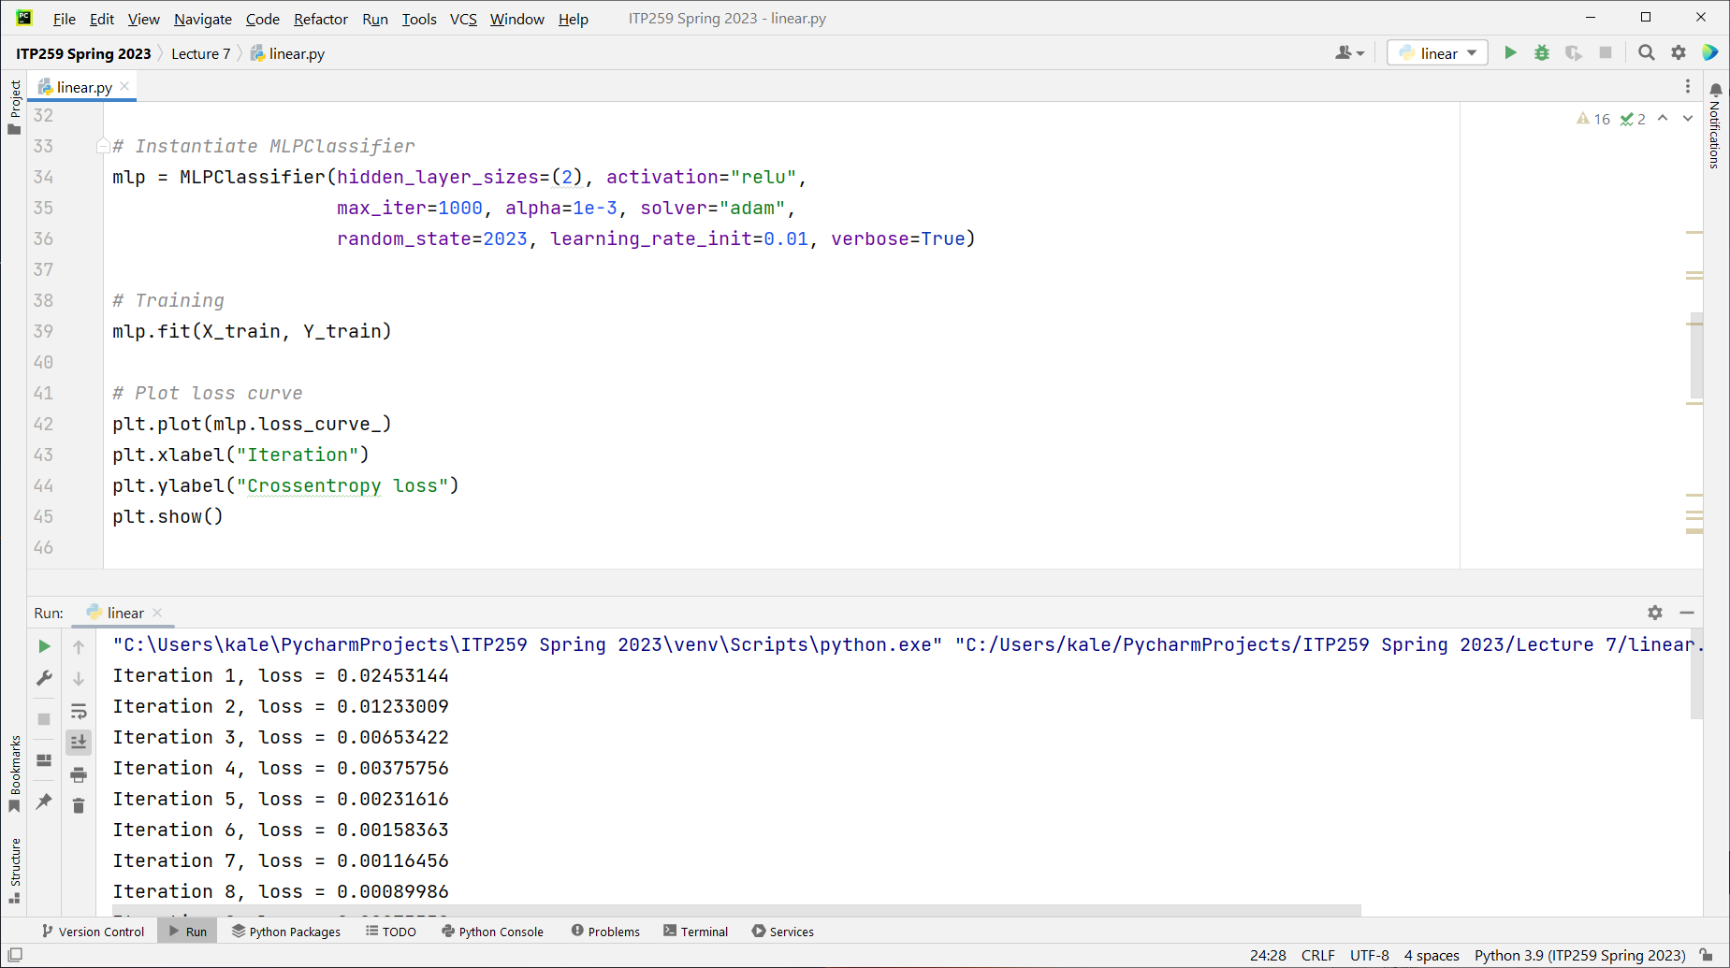
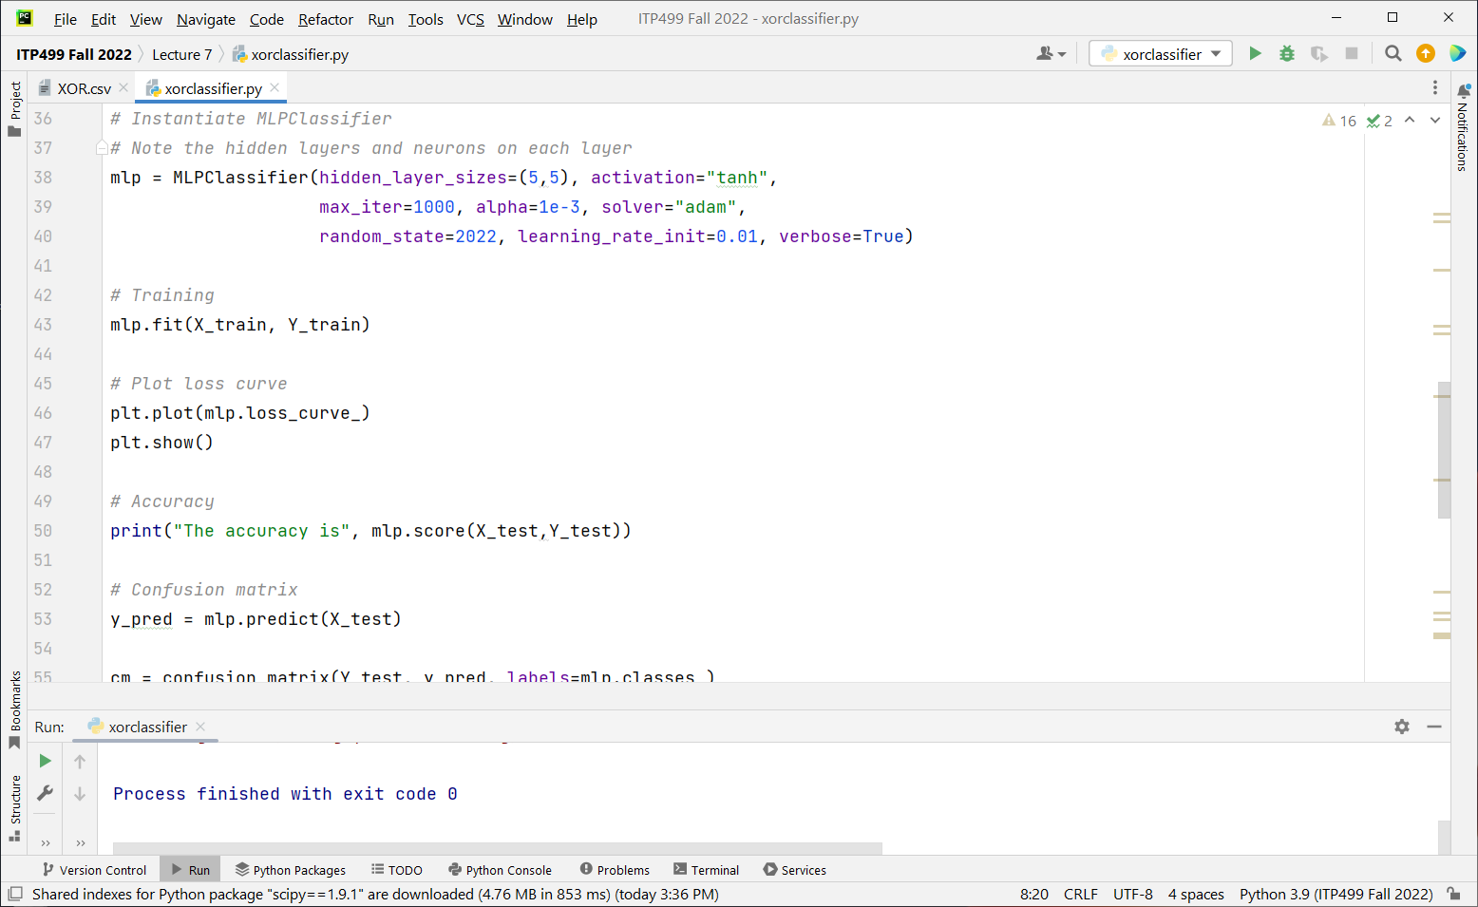
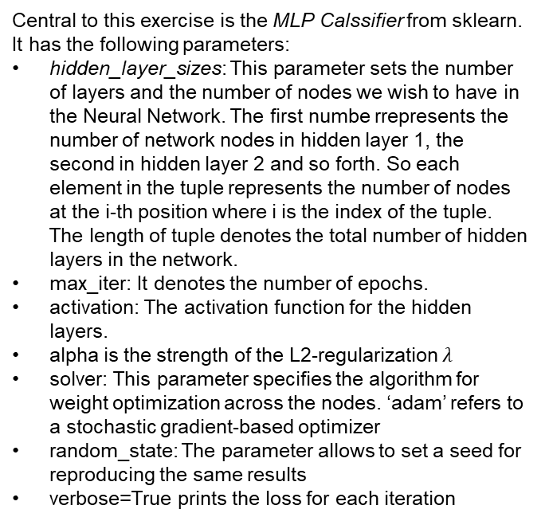
MLP Classifier
Central to this exercise is the MLP Calssifier from sklearn. It has the following parameters:
hidden_layer_sizes: This parameter sets the number of layers and the number of nodes we wish to have in the Neural Network. The first numbe rrepresents the number of network nodes in hidden layer 1, the second in hidden layer 2 and so forth. So each element in the tuple represents the number of nodes at the i-th position where i is the index of the tuple. The length of tuple denotes the total number of hidden layers in the network.
max_iter: It denotes the number of epochs.
activation: The activation function for the hidden layers.
alpha is the strength of the L2-regularization $λ$
solver: This parameter specifies the algorithm for weight optimization across the nodes. ‘adam’ refers to a stochastic gradient-based optimizer
random_state: The parameter allows to set a seed for reproducing the same results
verbose=True prints the loss for each iteration

Slide 27
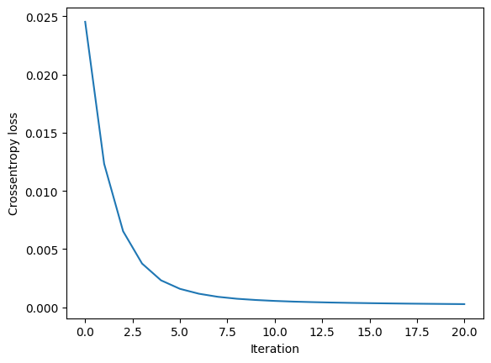
Loss Curve
We see that mlp.loss_curve_
uses the Cross-Entropy Loss (also called Log Loss) we encountered before
It uses a stochastic gradient approach. It is a form of Gradient Descent in which not all points, but only a small sample (or just one point) are considered when calculating the derivatives

Slide 28
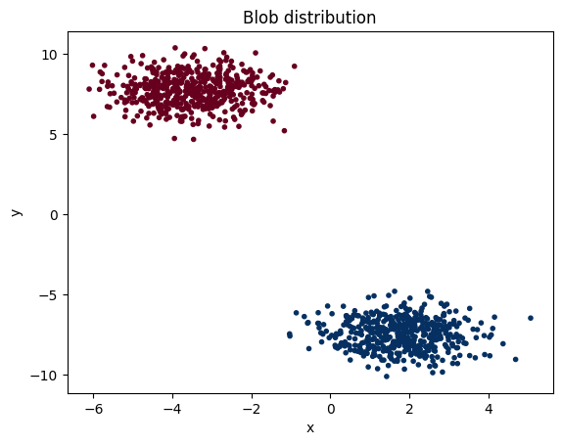
Input Blobs

Slide 29
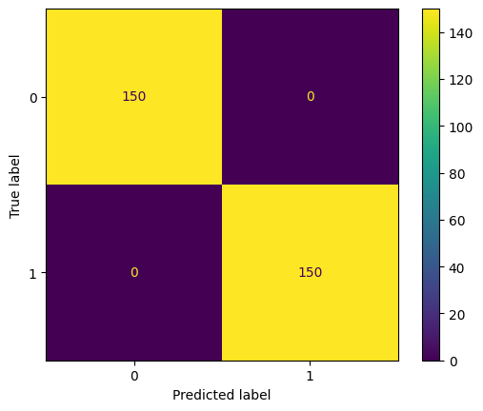
Confusion matrix

Slide 30
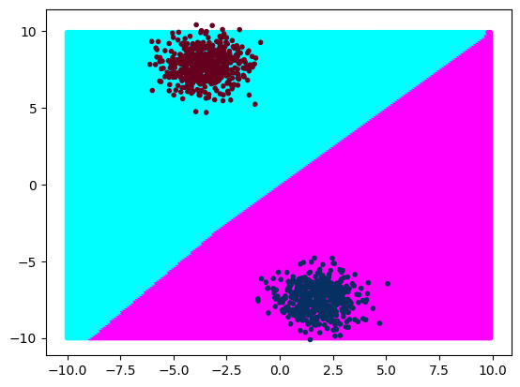
Decision boundary

Slide 31
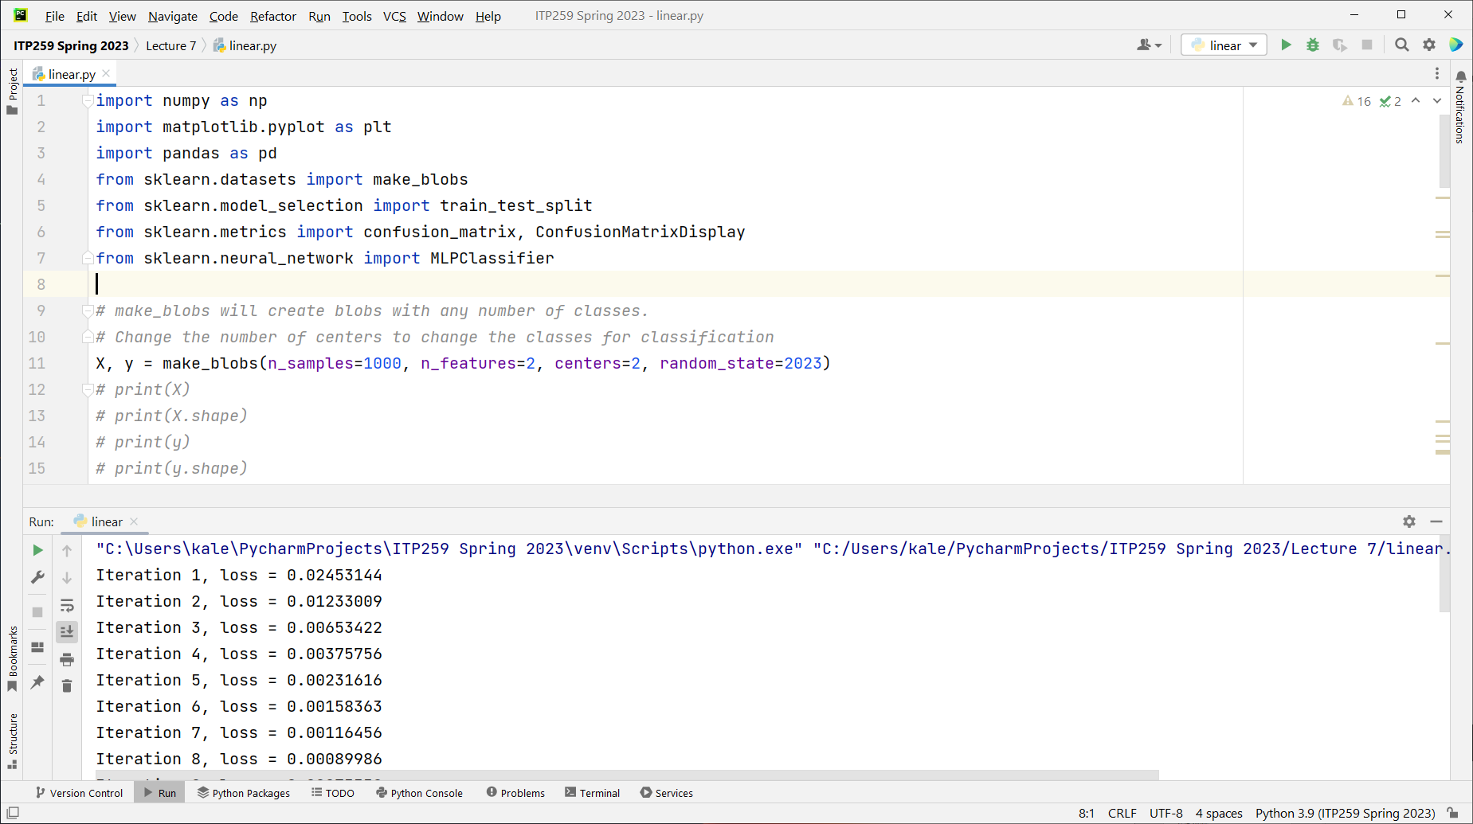

Slide 32
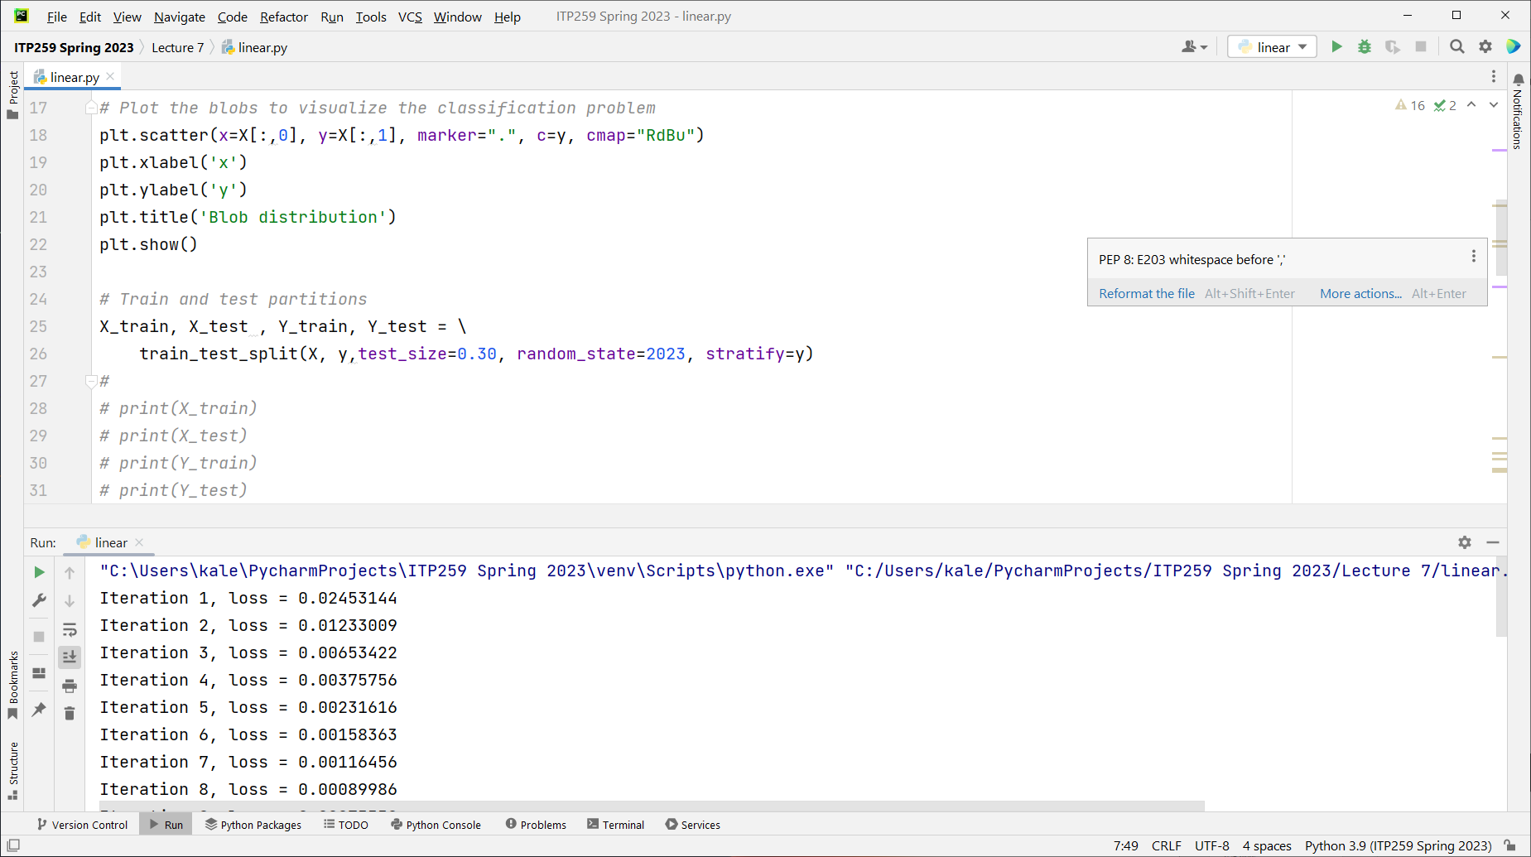

Slide 34
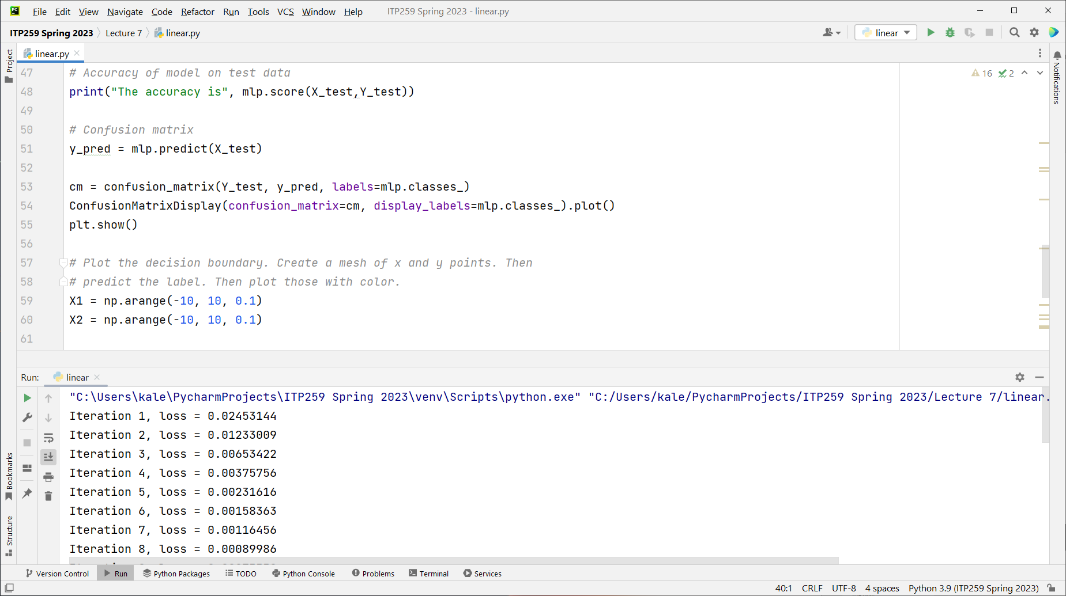

Slide 35
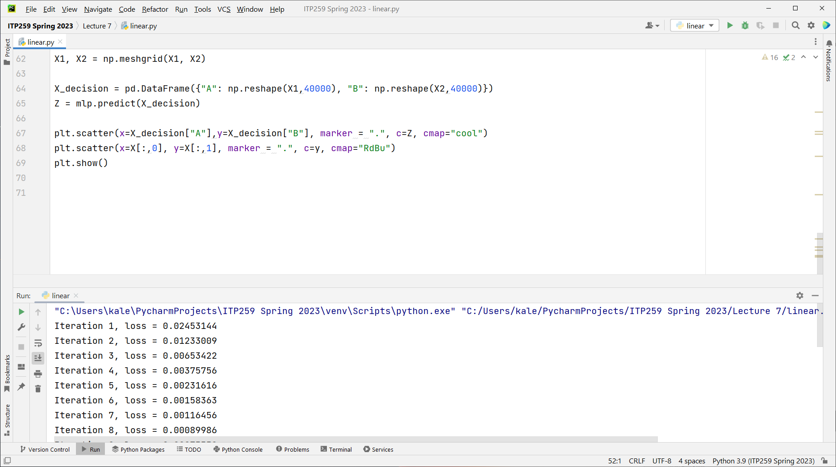

Slide 36
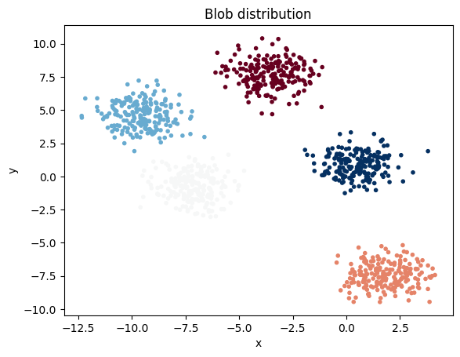
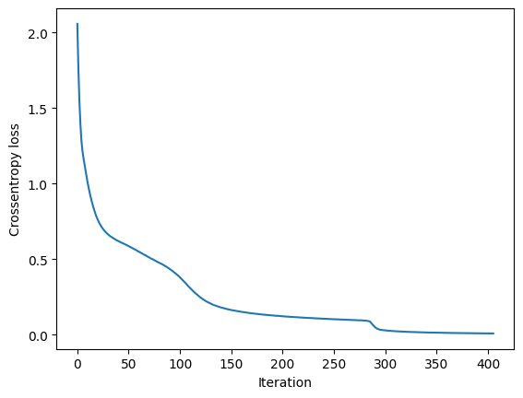
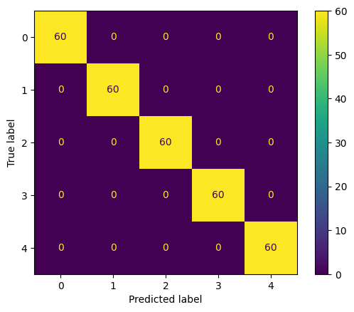
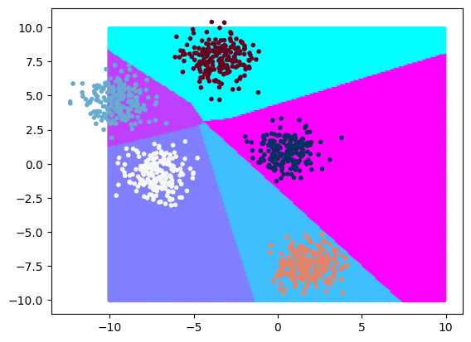
Try to classify 5 blobs

Slide 37
XOR blobs
XOR: Exclusive OR is a logical operation that is true if and only if its arguments differ (one is true, the other is false). In our case we look at if the arguments a positive or negative.
You are given a csv file with sample data of x,y coordinates for an XOR distribution similar to shown here.
Then follow the steps from the previous slide to classify the blobs into their classes (colors, 0/1)
Finally, plot the original blobs and the predictions. We do the predictions on a mesh of points that covers the entire plot area.

Slide 38
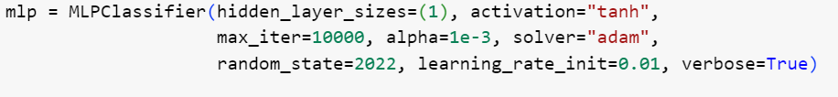
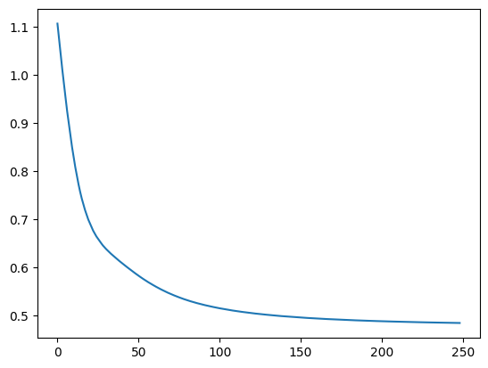
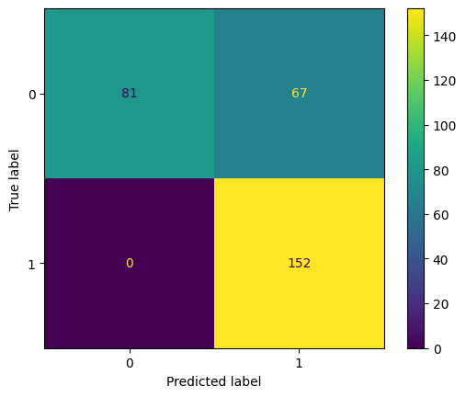
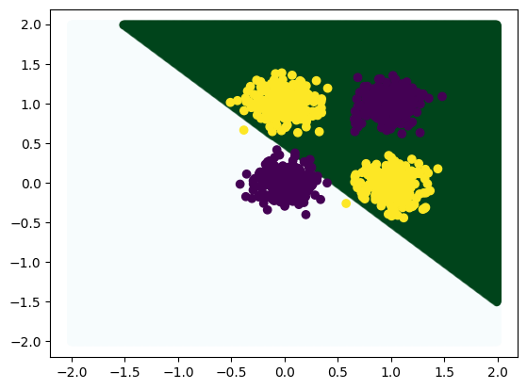
XOR blobs
This is a non-linearly separatable dataset; we will not be able to find the decision boundary using a Perceptron. Here is the result if we try:

Slide 39
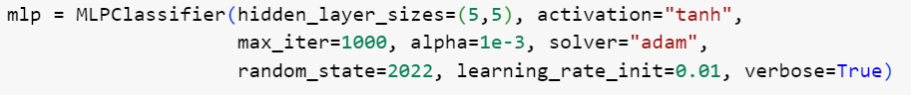
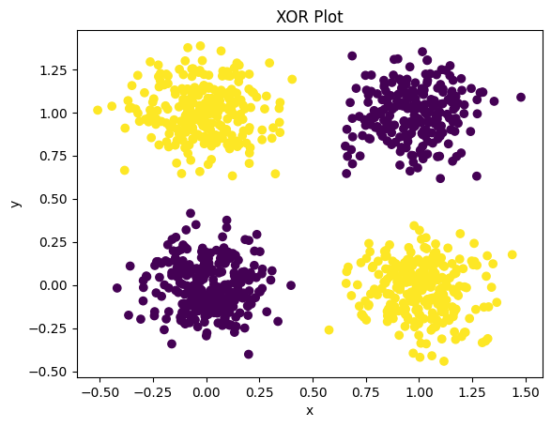
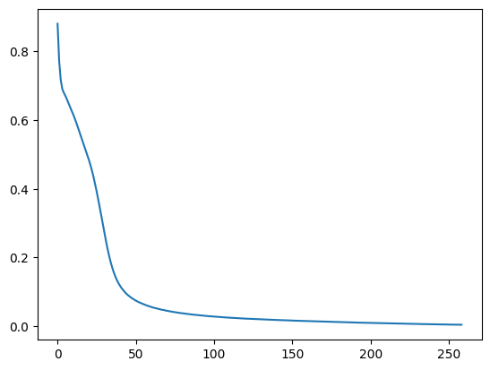
Lets try a bigger network (2 hidden layers, 5 nodes each)

Slide 40

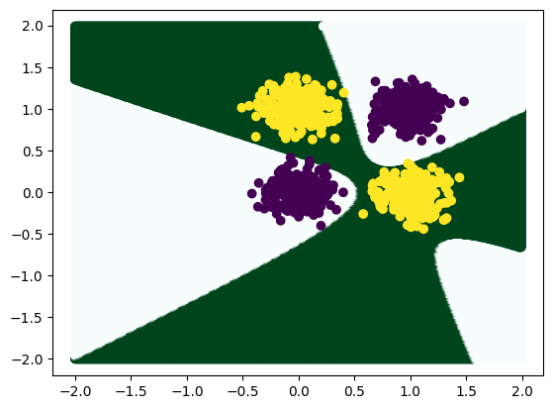

Slide 41
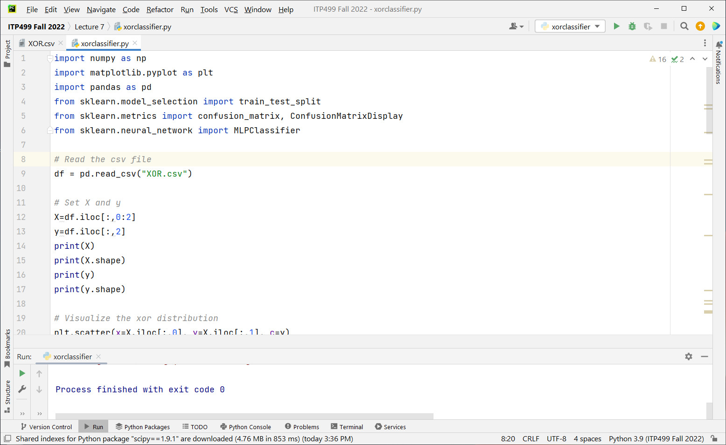

Slide 42
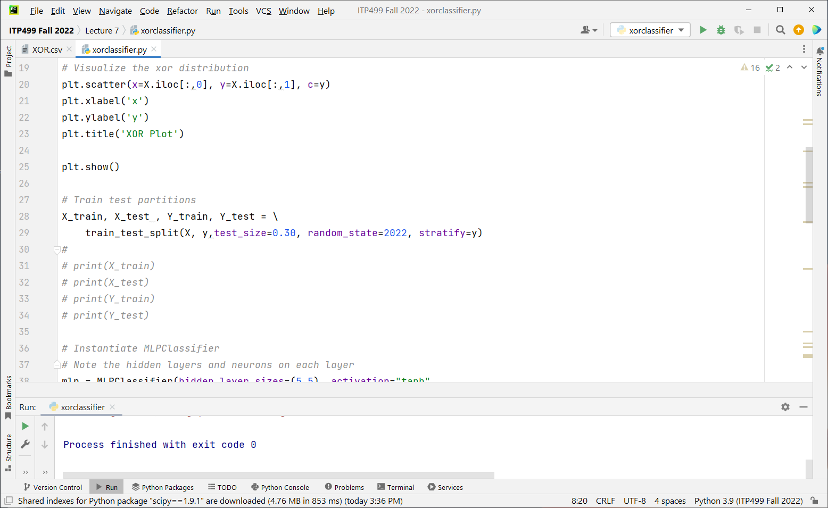

Slide 44
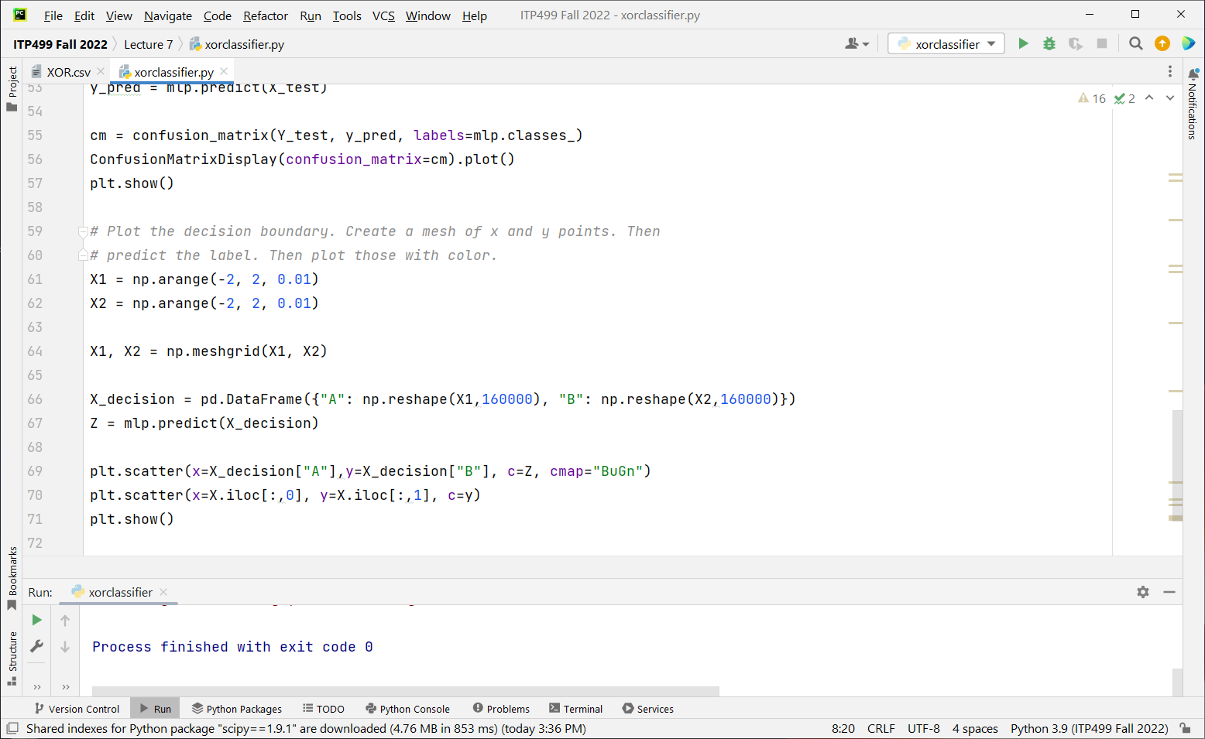

Slide 45
Circular blobs
Scikit learn has a make_circles function that can make a larger circle around a smaller circles of blobs.
Again a highly non-linear data set.
Then follow the steps from the previous slide to classify the blobs into their classes (colors, 0/1)
Finally, plot the original blobs and the predictions. We do the predictions on a mesh of points that covers the entire plot area.

Slide 46
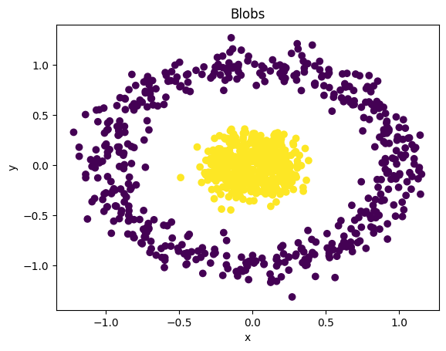

Slide 47
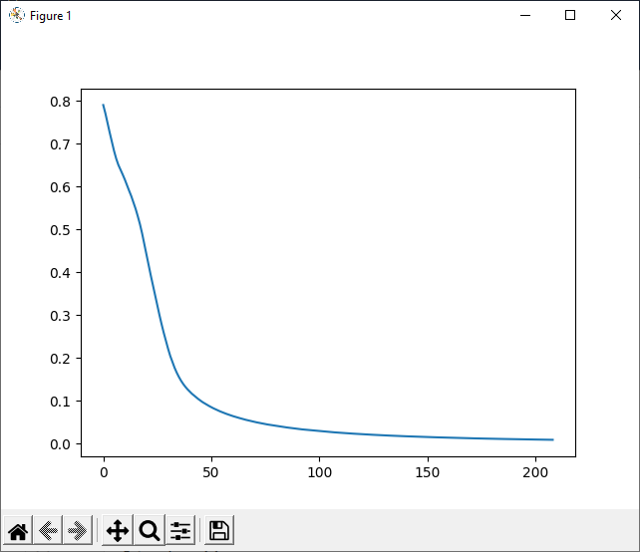

Slide 49


Slide 50


Slide 51


Slide 52


Slide 53


Slide 54


Slide 55
Summary
Demo of NN training
Choice of many parameters
Choice of a few datasets
Code multilayer NN from scikit learn to classify blobs

